Slide 1
The role of story telling during the childbearing years
Tere Garnons-Williams, RN RM BScN, MMid

Slide 2
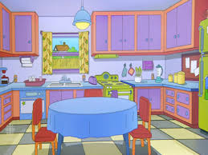
Once upon a Time…
Notes:
Once upon a time, there was a woman who was expecting her third child. She had a Midwife, who loved to listen to her stories and one day, when they were sitting together over a cup of tea, this is what she said:
““I was making tea one day, a few years back – when I heard Jack scream out to me from the shed ‘MUM! Come quick! It’s Pip!’ The slight irritation of being yelled at quickly changed to terror, as I heard the alarm in his voice. I rushed out the back door and into the shed – and found Pip literally hanging from a thick rope that had been dangling from the roof timbers – and a chair that was on its side just next to Jack’s feet. Jack was holding Pip’s legs, supporting her so the rope didn’t bear the full weight of her body – and Pip was holding the rope at her neck… Running forward, I grabbed up the chair, putting it under Pip’s feet and took hold of her feet, placing them on the chair, where she was then able to get her balance and loosen the rope around her neck…’

Slide 3
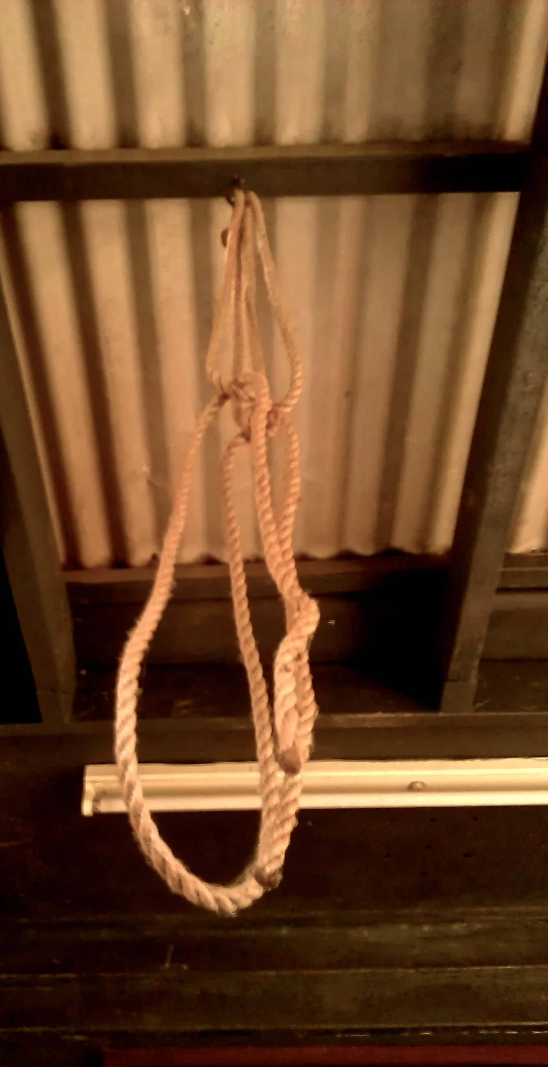
Mum! Come quick!

Slide 4
Mary sighed and looked away, her eyes losing their focus as she recalled the moment. She then turned and stared at me, looked me in the eyes and laughed. “I have no idea where THAT came from’ she said, shaking her head slightly.
Notes:
I said nothing, but noted everything. For some reason, it felt like important information and I kept it tucked away in case it proved significant.

Slide 5
Mary went into labour about a month later…
… and she went into the bathroom and into the shower stall, which was right next to the bath tub…
…She was sitting on the birth stool and her husband Andy was next to her, holding a warm towel on her back…
Notes:
Tell her birth story as it comes from you – keep it real, detailed and to the point: honour the mother …

Slide 6
…a chair that was on its side just next to Jack’s feet…
…and as she commenced pushing, the birth stool collapsed, one side breaking off completely…
Notes:
It cam time for her to push and she began to release her baby slowly. Being her third, I thought it would descend a bit faster than it was, but she was being really gentle. Slowly but surely, the head became visible, then a bit more of the head was seen and then a bit more.
She gave a sudden huge push and just as the baby’s head was crowning, the birthing stool collapsed, one side breaking off completely causing Mary to fall sideways, onto Andy’s chest. He reached out and grabbed the chair, to right it so that she could remain balanced. So she could get on with pushing her baby out without interruption.

Slide 7
Jack grabbed his sister’s legs taking the pressure off the rope…
You could see Andy straining, his face red from exertion as he held the stool up, half wedged between Mary and the bath tub…
Notes:
The baby’s head came out but I could see by the baby’s colour and the lack of lengthening at the neck that there was something holding it back – and because that story mMary had told me was so fresh in my mind, I knew the likely cause was the cord slowing the decent down… the scene was too remarkable: Andy holding the chair up, Mary grabbing her legs – and baby Mark dangling from his mother with the cord tightly around his neck…
At that moment, Jack came rushing into the room and let out a yell that shook the room: “Yes! I knew it! A brother!!”. Startled, Mark threw his arms out and with a deep breath, let out an almighty cry, pinking up immediately.

Slide 8
…she was then able to get her balance and loosen the rope around her neck…
I reached up and felt for the cord… it was wrapped tightly around the baby’s neck several times and I couldn’t loosen it.
I knew then what I needed to do…
Notes:
And the cord WAS tight around his neck – and unlike Pippa, I wasn’t able to loosen it.
In 30 years I have had maybe two occasions that have forced me to cut the cord. And this was one of them. With Andy still holding the birth stool up, with Mary holding herself in position,, I disentangled the cord and out came Mark, stunned, limp and with a colour that was less than satisfactory.

Slide 9
Using story to support healthy birth outcomes
Birth workers listening to women: prenatal, perinatal; and postnatal
Women listening to women: anecdotal evidence
Women listening to research: Narrative inquiry
Women listening to themselves: narrative therapy
Notes:
I’m going to briefly outline how we all can use the tradition of story telling to support our practice, our selves and each other in modern times. Note the word ‘listen’ in deeply embedded in each and this is not just by chance – it is by design. We need to start listening to each other – I mean “ACTIVELY” listening to each other – and ourselves. In order to support each other in birthing.

Slide 10
Prenatal, Perinatal & Postnatal care
“Creative expression can reveal a profound connection to the prenatal and perinatal dimensions of the human psyche”
Wobcke, 2009
Notes:
Marianne Wobcke (2009) in her honours thesis titled “Aboriginality, Art and the Perinatal” speaks of Genetic legacy: themes that pursue (us) craving creative expression to reveal and become aware of their deeper dimensions.
“Creative expression can reveal a profound connection to the prenatal and perinatal dimensions of the human psyche”
Wobcke, Marianne 2009 Honours Theory Research Paper, Qld College of Art Griffith University
(pg 2)

Slide 11
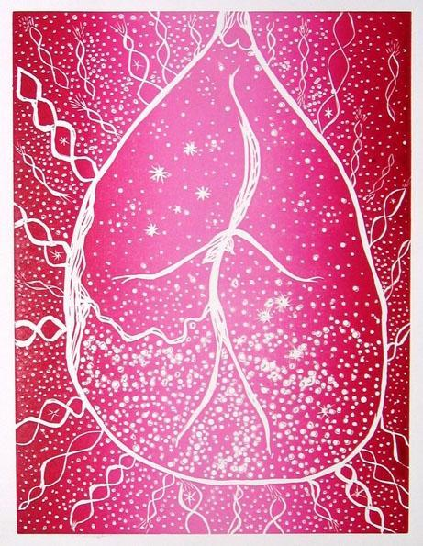
“Aboriginality, Art and the Perinatal”

Slide 12
Wobcke, 2009 “Aboriginality, Art and the Perinatal”
www.perinataldreaming.com.au
www.understandingcountry.com.au

Slide 13
The art of active listening takes…
Time
Receptive
Trust
Notes:
TIME:
We have got to take the time to allow women voice. We have to allow time – time to listen to the stories and get to know what makes the women we care for ‘tick’. What are they trying to tell us when they tell us their stories?
RECEPTIVE:
In order to offer holistic care, we have to listen holistically.
Yes/No answers to the huge numbers of questions on an antenatal form is not good enough. Ticky box care is not enough.
TRUST:
Time & receptivity can lead to trust. Being ‘with’ women can lead to a trusting relationship.

Slide 14
Antenatal and postnatal ‘education’
Anecdotal: learning from each other, sharing our stories. Women’s support groups
Contextual
Holistic
Applicable
Notes:
Humans learn best by touching, feeling, seeing and listening. Story has that capacity in that it is usually personal, usually told by someone we can identify with about a topic we feel is relevant to our needs NOW. It usually is holistic, in that it relates to a physical situation, has an emotional theme (why else would we share it?); has a sense of spirit/soulfulness; and a hint of cultural or social flavour.
Yarning circles, women childbirth support groups
We remember story. Our imagination allows us to store the story – and the impression it has made on us. So we can pull it out and act on it, on what we learned from hearing the story – at a time when we need that bit of information.
“…where the intent is not to seek or give advice, but give women the opportunity to talk, without a great end in mind, but with the potential to build pictures of things, ideas – as foundations for actions later on” (Garnons-Williams, 2003 p. 116)

Slide 15
Research
Narrative Inquiry: “…qualitative paradigm, allowing the researcher to inquire into social or human phenomena within a natural setting and to build a complex and holistic picture that is formed with words.” (Creswell, 1994 as cited by Garnons-Williams, 2003)
Notes:
…or both? More and more we are seeing research that incorporates both statistical analysis (i.e. using hard data to prove a point) and thematic analysis (i.e. using soft data to explore hypothesis)
Acceptance of Narrative inquiry as scientific research. Preparing for motherhood – a narrative inquiry into alternative pregnancy care practices” (Garnons-Williams, 2003)
***Briefly discuss your thesis or Use only the abstract/conclusion if there is time

Slide 16
Narrative therapy
Journal writing
PTSD
Birth Talk TM (Debbie Gould)
The Write Road TM (Stephanie Dale)
Notes:
20 years ago, I had a woman ask me to support her in having a home birth after she had a section for her first baby 3 years previously. She was miles away in some remote part of Australia and would be moving to my area at about 6 months gestation. I asked her to write her story about her first birth. I asked her to put everything into it: thoughts, feelings (anger, hurt, betrayal – everything) and to send it to me to read. I said it would be a way that I could get to know her – and a way for her to get to know herself and have a chance to ‘look’ at that birth.
It was also a way for her to let go of that birth.
I came across that story she sent me years later. I called her up and organised to give it back to her. I suggested that she give that story to the child involved so she too, could feel it – and let it go (after all, it was her story too)
Every woman does something different and unique with their story. I’ve known women who burn it; rip it into pieces; do a ritual burial, send it out to sea. Above all, they let it go – they become aware that it was THAT story – and now, there is another story with this, another baby…
Alison was going to send me stuff that I will condense in order to explain what it is.
Birth Talk – can be an online session, over the phone or in person.

Slide 17
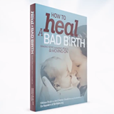
Birthtalk.org
“Making sense, making peace and moving on”
Notes:
Healing from a previous birth; planning a positive birth; support and education after a cesarean section…

Slide 18
thewriteroad.com.au
Our vision is to get the nation writing…
Notes:
“…our objective is the resurrection of creativity in everyday life. As a priority… securing the mental and physical wellbeing of the nation… We are on a mission to empower people to tell their story their way.” (Stephanie Dale, 2014)

Slide 19
…and they all lived happily ever after…
The End
Notes:
Thanks to Mariane Wobcke, Debby Gould and Stephanie Dale for their input. And most of all, my thanks goes to women who willingly share their story. Because it these stories that will change the world so that we will indeed, live (and birth) happily every after.

